Slide 1
Analyzing Large-scale Drug Related Data Supported by Graph Modeling: Preliminary Results
Amrita Anam, Jianwu Wang, Qian Zhu, Aryya Gangopadhyay
University of Maryland Baltimore County

Slide 2
Linked Open Data
Resource Description Framework/ N-triples
Data Model by w3 consortium
Represents web pages with Uniform Resource Identifier(URI)
Expresses connections on the semantic web

Slide 3
Linked Open Drug Data
Connects various sources of drug related data on the semantic web
Data contains URIs related to
Drugs, diseases, interventions, genes, targets etc.
N-triple
Subject ->URI
Predicate ->URI
Object ->URI or literals

Slide 4
Graph Data
Nodes – entities
Identified by a unique identifier
Defined by a type (category)
Can have incoming and outgoing edges
Can have multiple attributes

Slide 5
Graph Data
Edges – relationships between nodes
Defined by a type (category) of relationship
Can have multiple attributes
Can be directed or undirected

Slide 6
Why Graph Modeling?
Flexible schema and data models
Meaningful sub-groups
Graph analytics that can be used for analyzing neighborhood, hidden cliques
Area: drug repurposing, personalized medicine
Visualization of query results

Slide 7
Graph from LODD
Unique nodes from subject and object URIs
Unique edges from predicate URIs
Define Type
Set Attribute
Define Type
Set Attribute
Create graph
Save “literals” as attributes

Slide 8
Data Structure
N-triples Data
Graph Data
DB00875
Source: DrugBank
Triples: 700k
<http://www4.wiwiss.fu-berlin.de/drugbank/resource/drugs/DB00875> <http://www4.wiwiss.fu-berlin.de/drugbank/resource/drugbank/drugCategory> <http://www4.wiwiss.fu-berlin.de/drugbank/resource/drugcategory/thioxanthenes>
neo4j
Nodes: 100k
Edges: 200k
Node
drugCategory
Edge
Node
thioxanthenes

Slide 9
Data Model 1
Simple model
Directly mapped from RDF/n-triple
No type(s) defined for nodes or edges
No hierarchy established

Slide 10
Data Model 1
Advantages
Disadvantages
No domain knowledge required
Less information to store
URIs are just strings without definitions
Need to know URIs to query

Slide 11
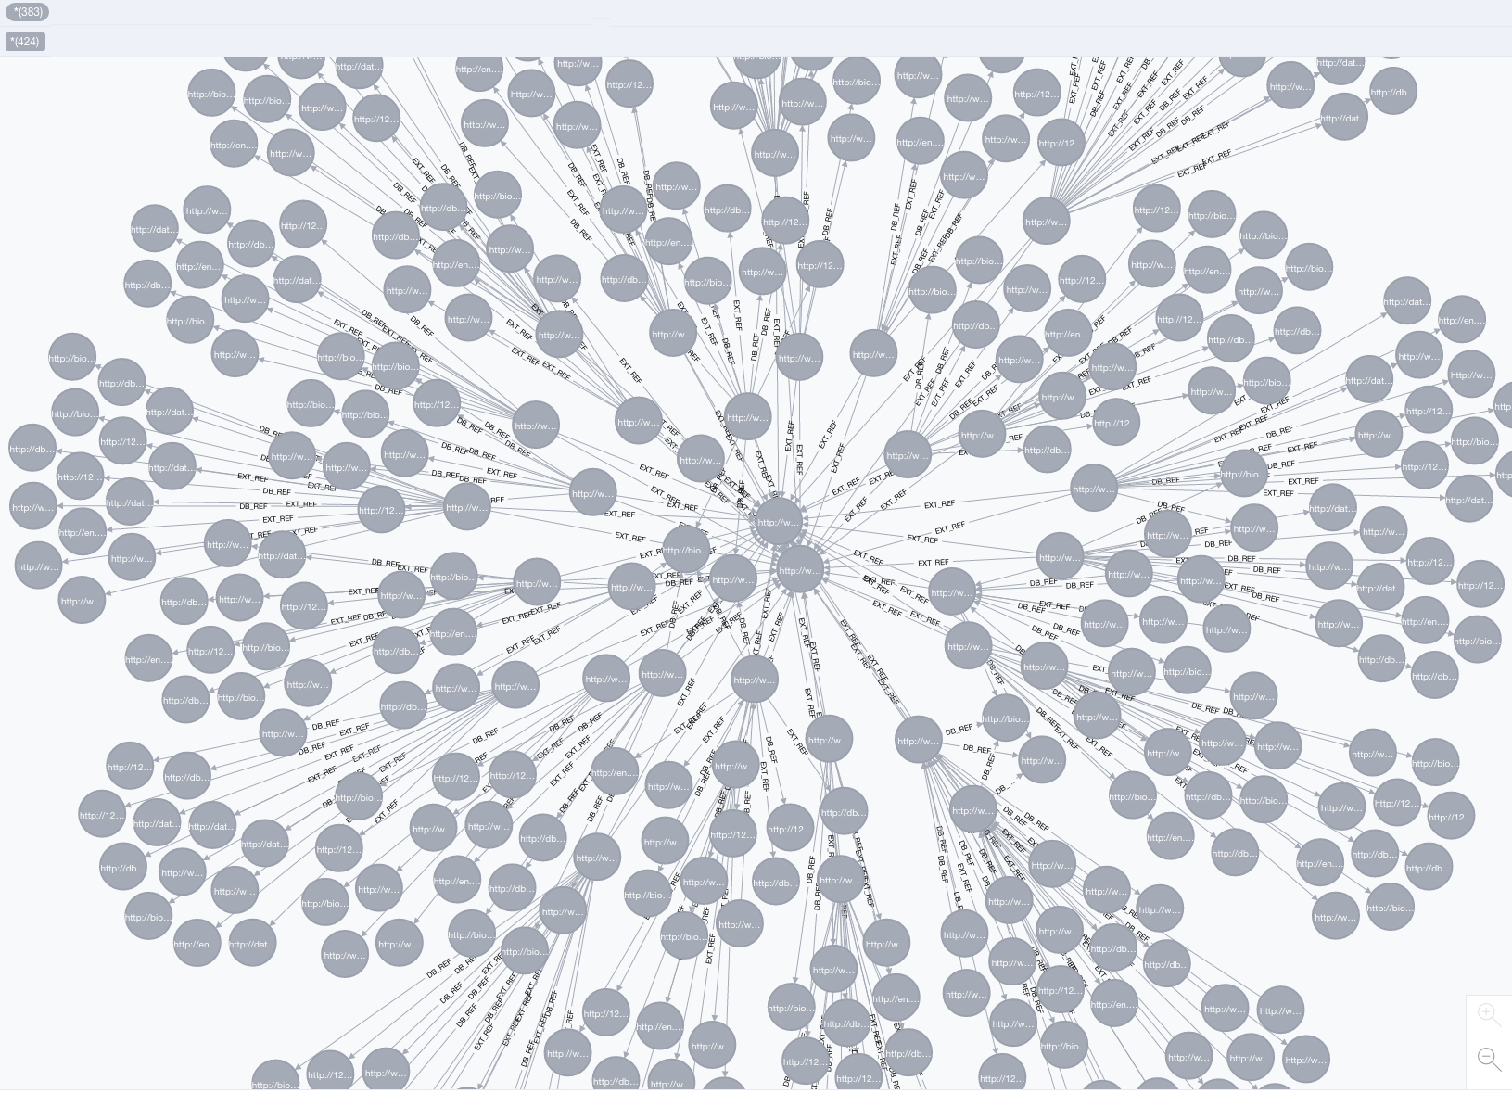
Graph: Data Model 1
Example: DrugBank data showing all URIs as nodes and their relationship as edges

Slide 12
Data Model 2
Advanced model
Nodes and edges have type(s)
URIs represented as real world objects
Any additional information is stored as attribute

Slide 13
Data Model 2
Advantages
Disadvantages
Can be queried on node-type and edge-type
Multiple levels of hierarchy can be established
Well-defined schema required
More overhead and size

Slide 14
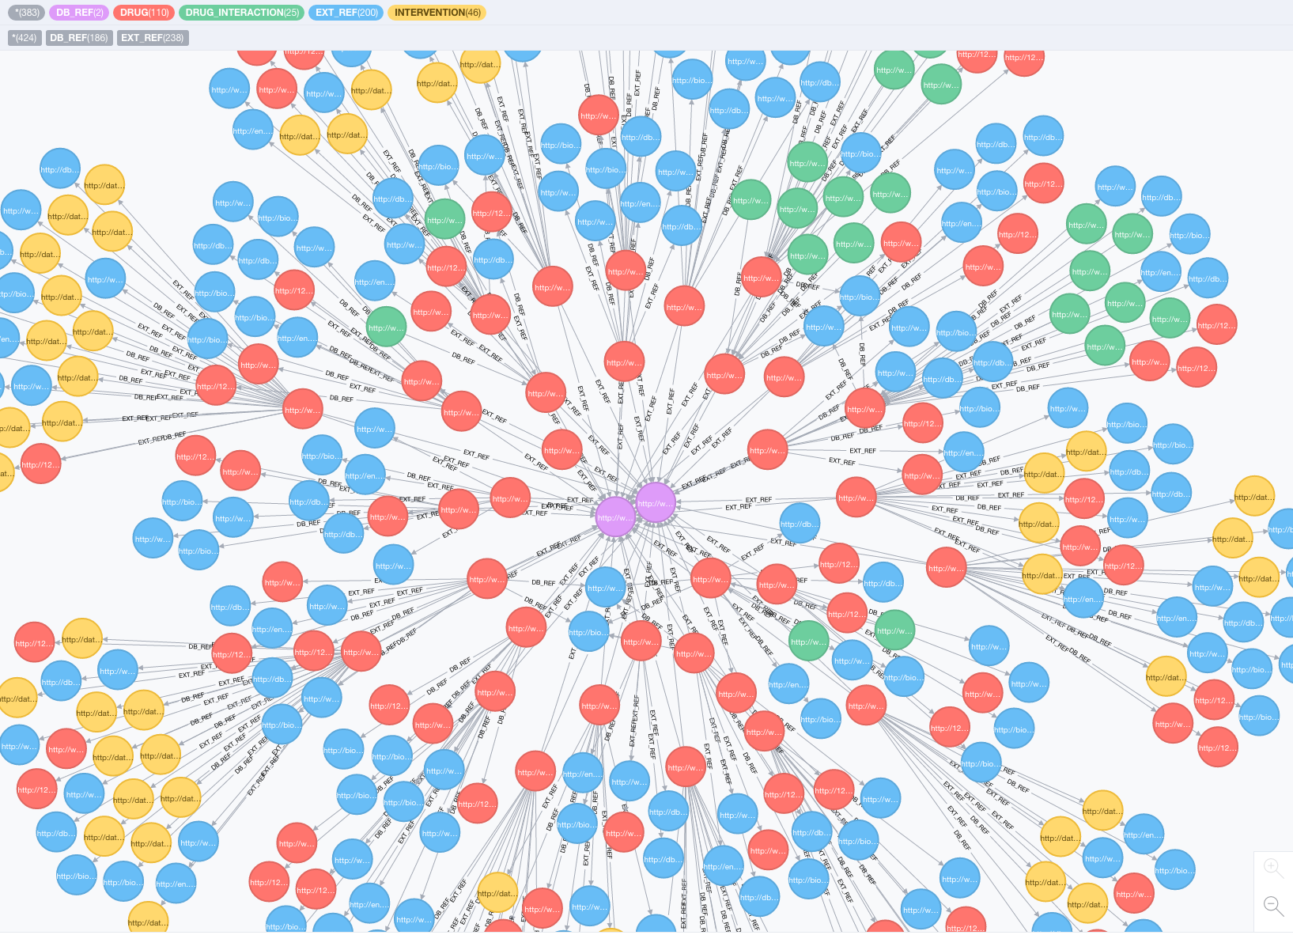
Graph: Data Model 2
Example: DrugBank data showing URIs as drugs, targets, interventions etc.

Slide 15
DrugBank Data
Example: Node Types
Example: Edge Types
DRUG
INTERVENTION
GENE
PROTEIN
DISEASE
TARGET
rdf-syntax-ns#type
rdf-schema#label
owl#equivalentClass
owl#equivalentProperty
owl#sameAs

Slide 16
Advantages over RDF Query
Graph query
Allows negation (NOT operation)
Allows shortest path calculation
Edges can have attributes
Local storage ensures availability

Slide 17
Graph Algorithms
We performed basic graph algorithms using only queries
Network Characteristics
Connected Components
Network Diameter
Node Importance
Degree Centrality
PageRank

Slide 18
Neighborhood Analysis
Compare sub-graphs
Diseases Networks
Drug Networks
Use logical operators to merge graphs
Union, intersection

Slide 19
Neighborhood Analysis
Azathioprine
Mycophenolic acid
Ribavirin
Mercaptopurine
Mycophenolate mofetil
Thioguanine
Figure shows 6 drugs and their neighbors
All are targets for the same disease

Slide 20
Future Work
Distributed graph analysis
Optimization of query
Data integration by integrating graphs from different sources
Compare and contrast disease networks for drug repurposing

